Slide 1
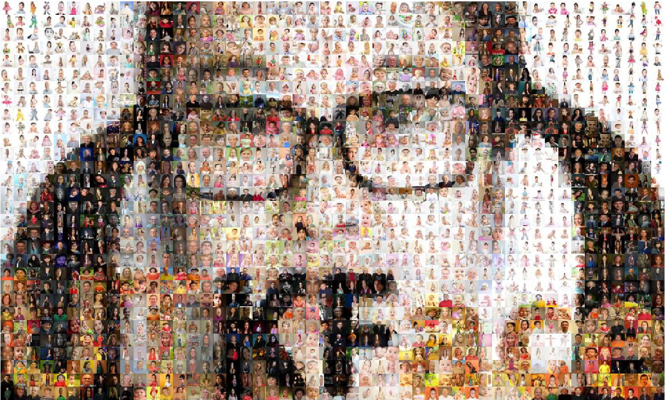
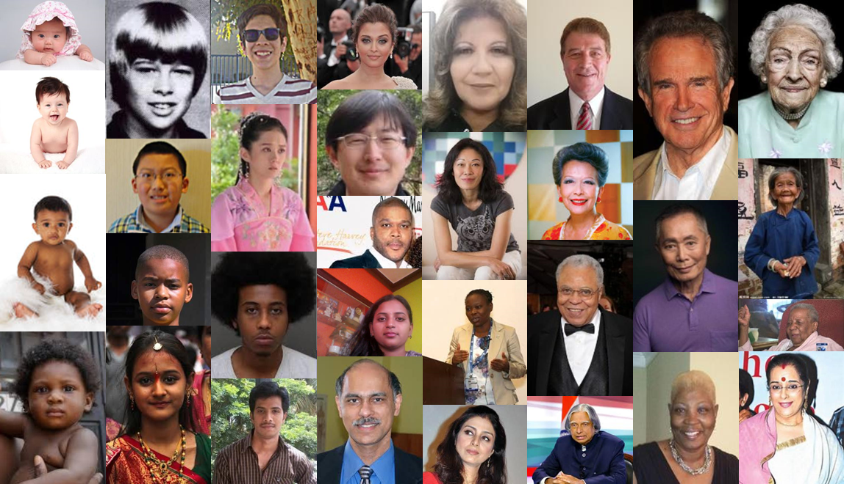

DSE I2100 Project:
Human Face Characteristics exploration
Members:
Thomas Ly
Yinzi Xiang
Jenifer Vivar
Oxana Firsova
Instructor: Michael Grossberg

Slide 2
Objective of our project: Feature Engineering
To correctly identify the age, race, and gender of a person via the input of a single image. All three variables will be treated as classification problems and will be tested to see if models can outperform simple and dummy models. In addition, two models will be selected from testing, one that is quick to train and accurate, and one that is meant to be accurate regardless of training duration.

Slide 3
Why do facial recognition?
Broad field with many potential use cases in day-to-day life
Improve medical treatment via identification of symptoms
Save time by removing steps in secure identification (Driver License, Documents)
Opt in can save time by reducing log in time

Slide 4
What we have accomplished so far
Dummy model control accuracy
Developed Simple models: K-Nearest-Neighbors, Logistic Regression
Tested preprocessing techniques: PCA, RFS, SIFT, Label Balancing, Masks
Tested and compared complex models: SVM, CNN, Random Forest, Gradient Boost Classifier
Picked GBC, CNN for best accuracies and differing training methods
Hyperparameter tuning both GBC, CNN

Slide 5
UTK Face Dataset
Cropped & aligned facial images with age, race, gender labels
23,000 images in total from dataset
Image shape = (200, 200, 3)
Age labels modified into classification labels using 9 stages of life standard
Unbalanced data having mostly White as race and todlers (0, 3) as age.

Slide 6
Data Preprocessing+EDA

Slide 7
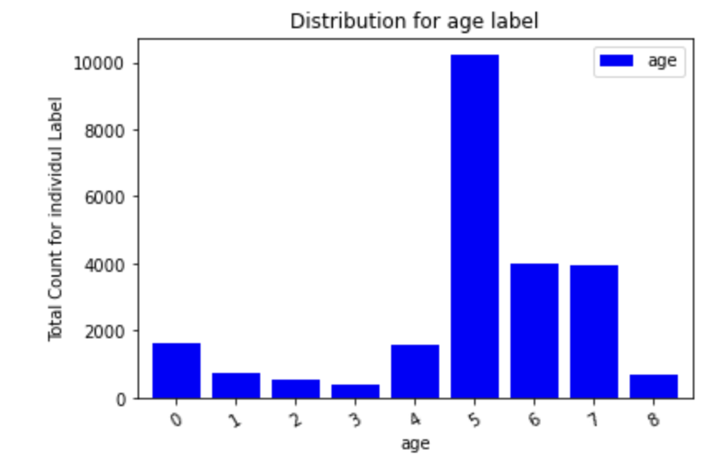
Age Labels/variables
0: infancy (0-2)
1: Early Childhood (Age 3-5)
2: Middle Childhood (Age 6-8)
3: Late Childhood (Age 9-11)
4: Adolescence (Age 12-20)
5: Early Adulthood (Age 21-35)
6: Midlife (Age 36-50)
7: Mature Adulthood (Age 51-79)
8: Late Adulthood (Age 80+)

Slide 8
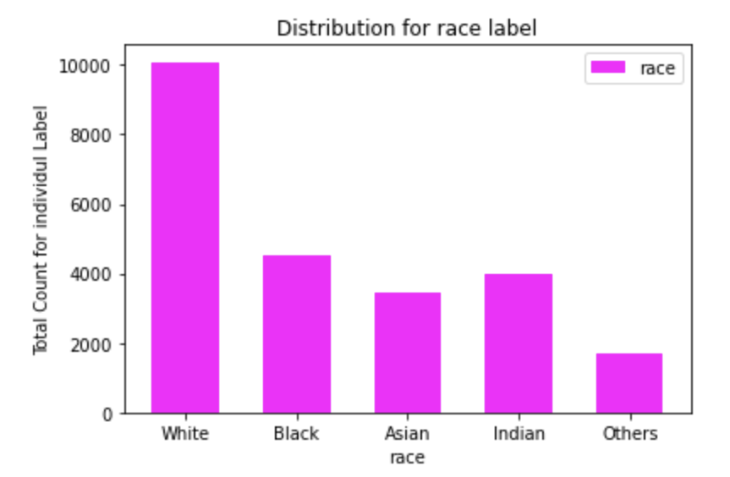
Race Labels/Variables

Slide 9
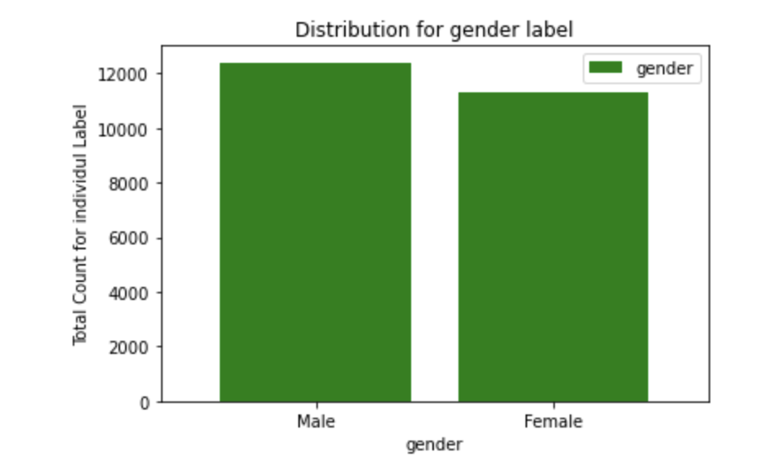
Gender Lables/Variables

Slide 10
Balancing the all the labels

Slide 11
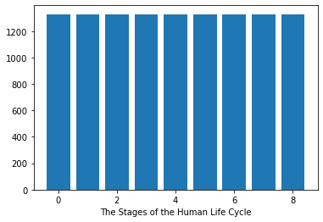

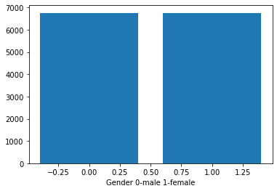
Age/Race/Gender Balanced Labels

Slide 12
Simple Model

Slide 13
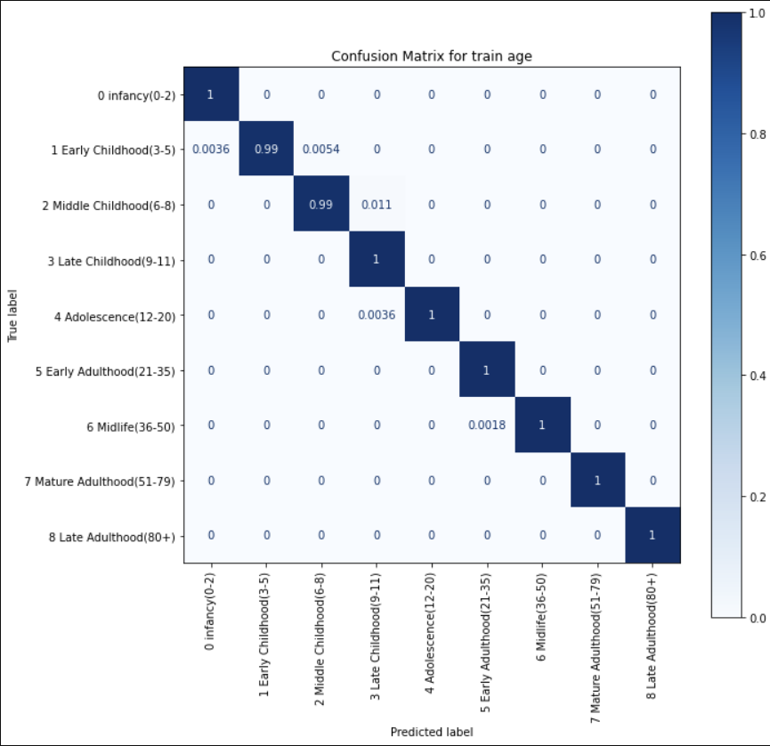
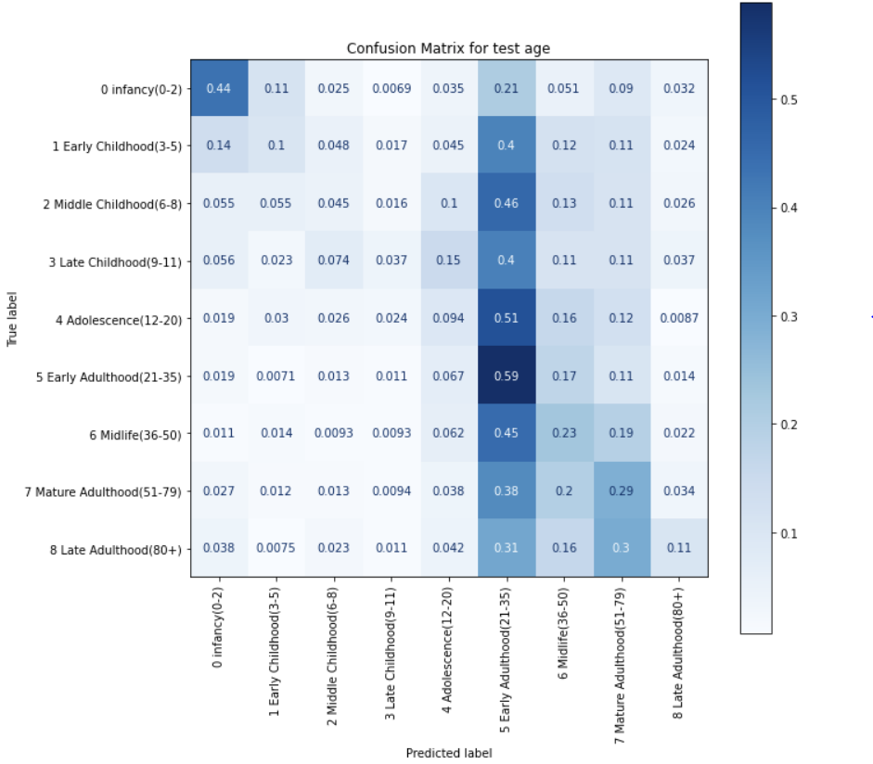
Develop a simple model for comparison: K-Nearest-Neighbor age balanced train vs test
Training accuracy: 0.99 Testing accuracy: 0.27

Slide 14
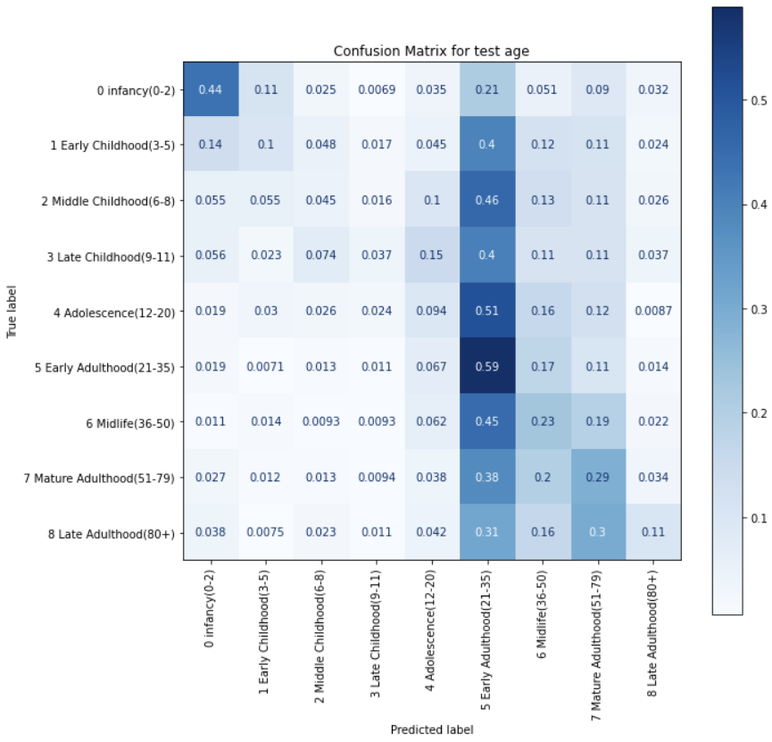
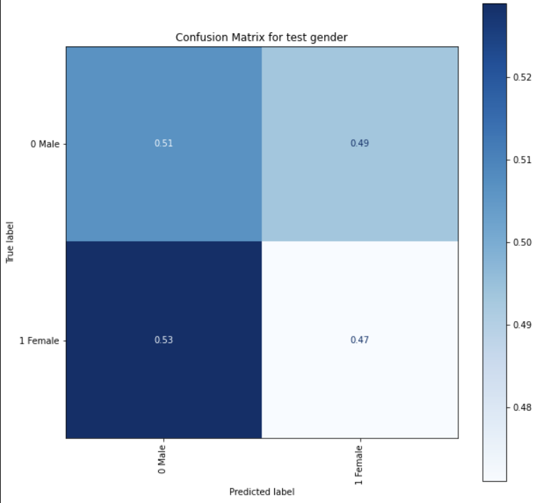
Develop a simple model for comparison: K-Nearest-Neighbor test gender and race
Testing Race accuracy: 0.39 Testing Gender accuracy: 0.49

Slide 15
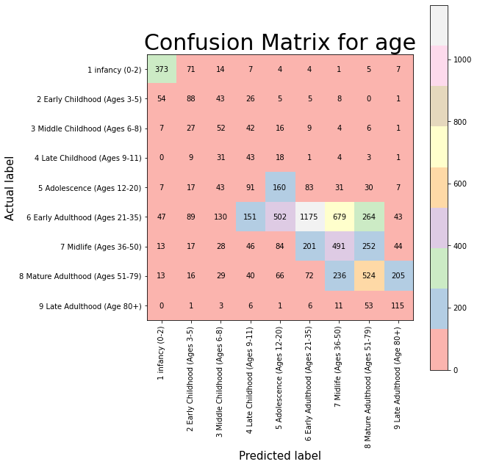
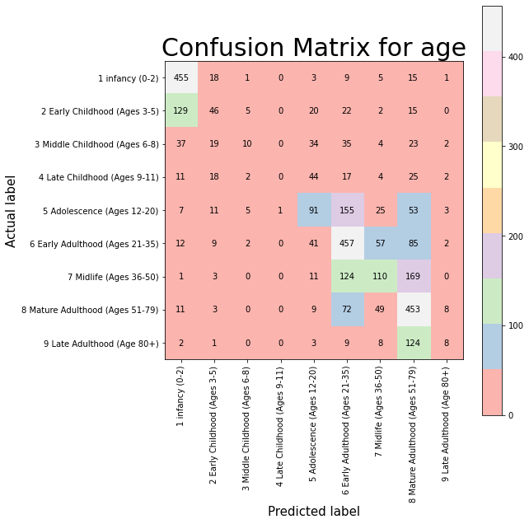
Develop a simple model for comparison: Logistic Regression balanced vs unbalanced
Train accuracy: 0.7039039039039039
Test accuracy: 0.4614860259032038

Slide 16
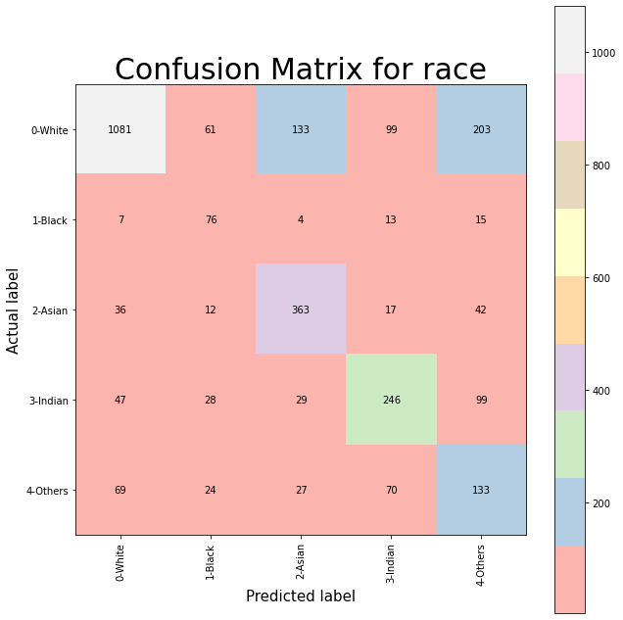
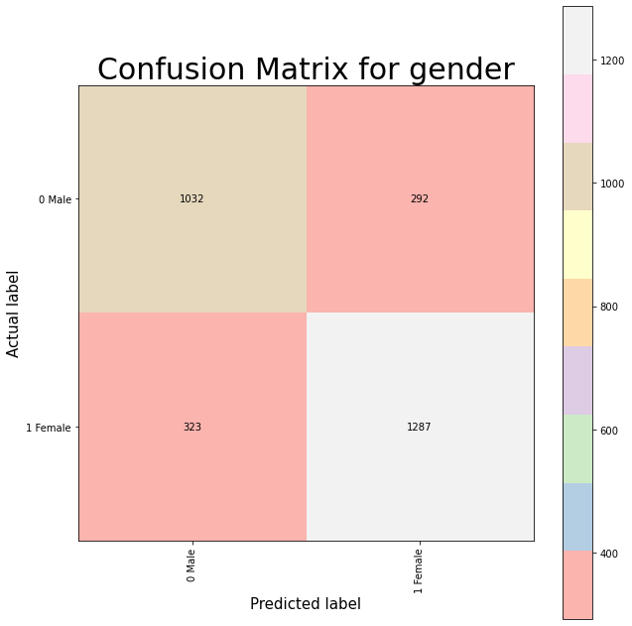
Develop a simple model for comparison: Logistic Regression Race/Gender
Train accuracy: 0.7912 Train accuracy: 0.891
Test accuracy: 0.647239263803 Test accuracy: 0.7903885480572597

Slide 17
Applying Image Masks

Slide 18
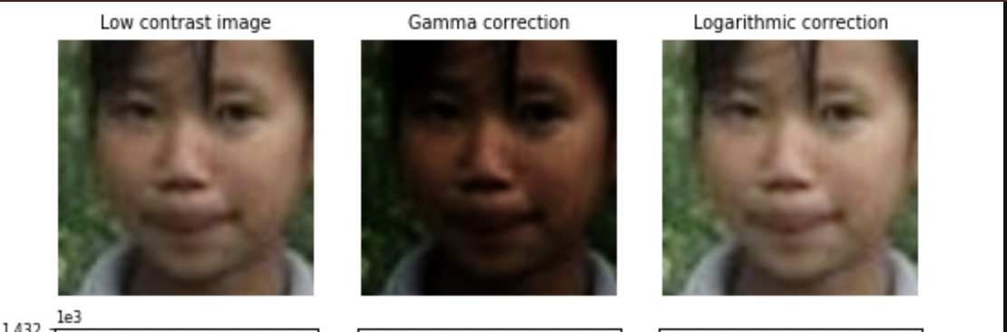
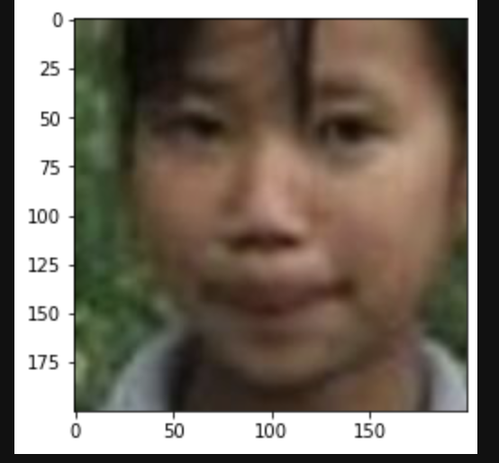
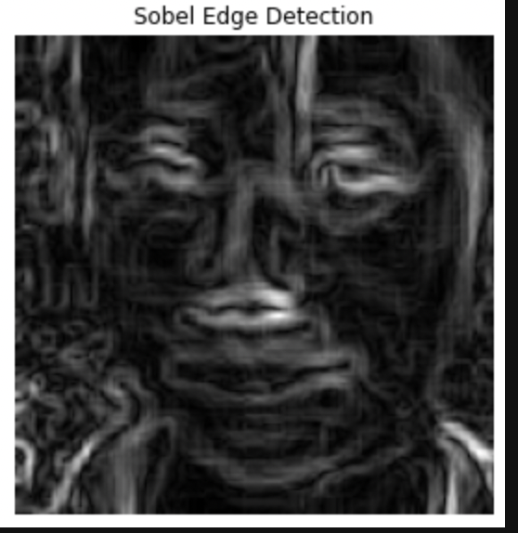
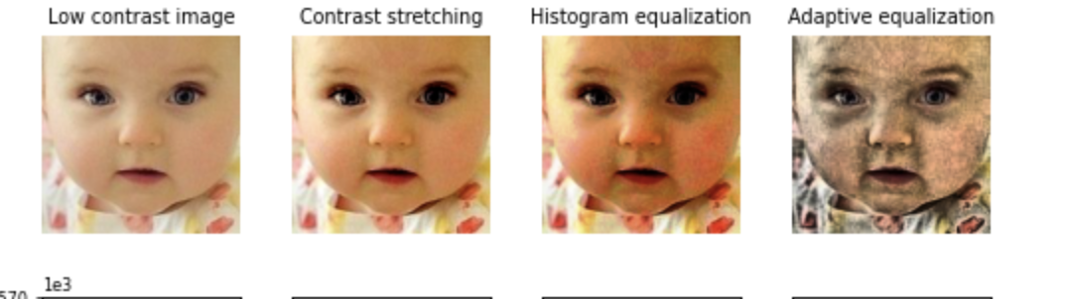
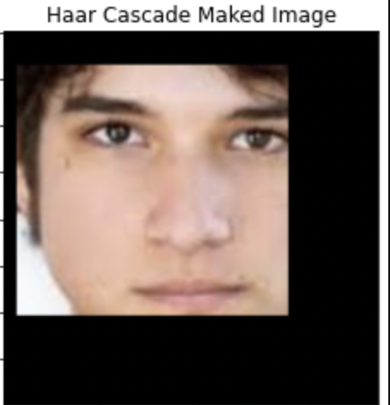
Pre-processed and Processed Images

Slide 19
SIFT Image Processing

Slide 20
SIFT Comparison between models
SIFT: A technique for reducing data complexity by counting common points in an image
 | CNN Variable: Age | Gradient Boost Variable: Age | Random Forest Classifier Variable: Age | SVM Variable: Gender
With SIFT | Speed: 5s ValAcc: 0.4180 | Speed: 1s ValAcc: 0.37 | ValAcc: 0.48 | Speed: Few Minutes ValAcc: 0.55
Without SIFT | Speed: 460s ValAcc: 0.5820 | Speed: 148s ValAcc: 0.52 | ValAcc: 0.55 | Speed: 10s ValAcc: 0.73

Slide 21
SIFT Take aways
Time: SIFT can divide training time by over 100 compared to the full image dataset
Accuracy: This comes at the cost of accuracy from 10 to 20 percent for all models
Overall: If a model has high accuracy and long training time, it may be worth it to trade some points of accuracy for ease of training and interpretability

Slide 22
PCA & RFS

Slide 23
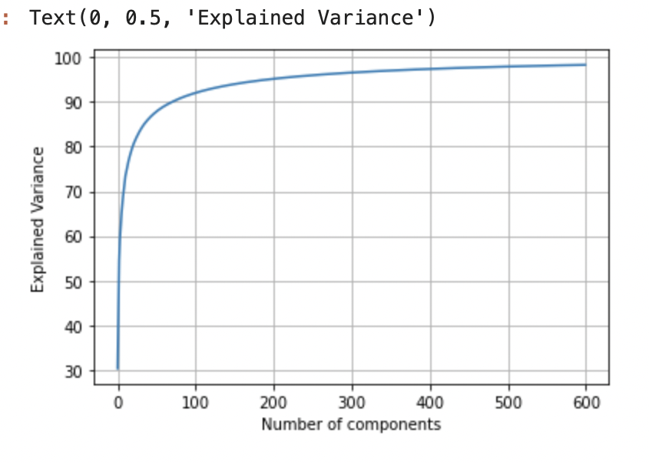
Feature Extraction - - PCA
After gray scale our images dataset and then apply the PCA, we got 195 components is best to explain the most variance for our dataset.

Slide 24
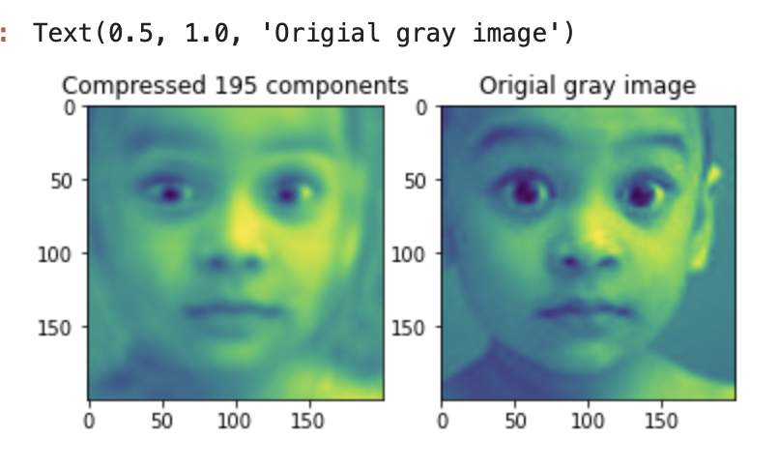
Feature Extraction - - PCA
On the left is the PCA compresed image.
On the right is the Gray scale image.

Slide 25
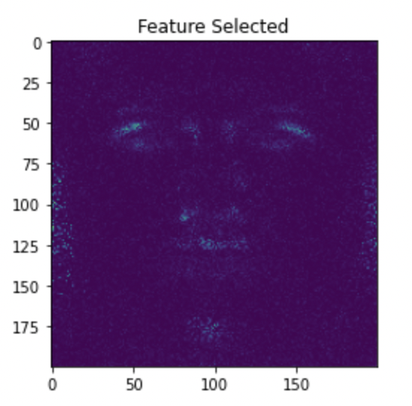
Feature Selection - - Random Forest Feature Importance
ance
After we grayscale our image dataset, we applied the Random Forest model on the dataset and then selected the features according to the random forest feature importance attribute. Here we got 12794 features from 40000 features.

Slide 26
Complex Model Training and Comparison

Slide 27
Experimenting Random Forest Classifier

Slide 28
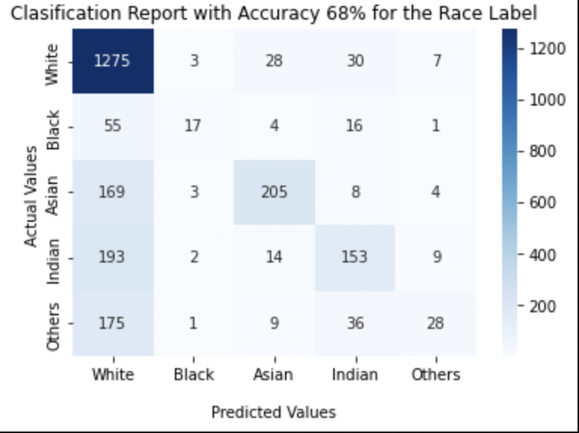
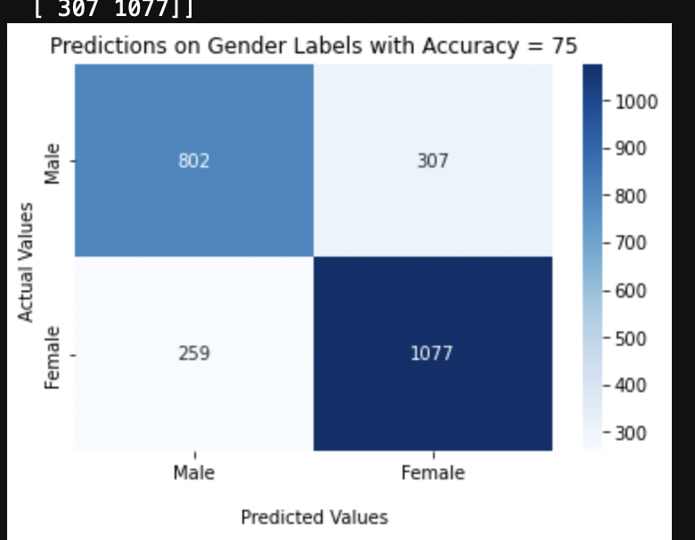
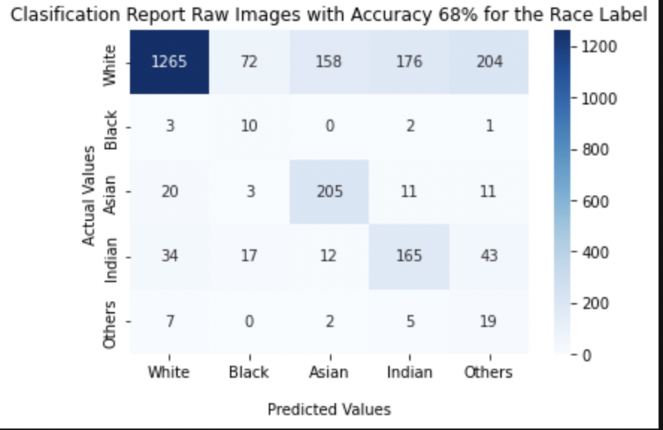
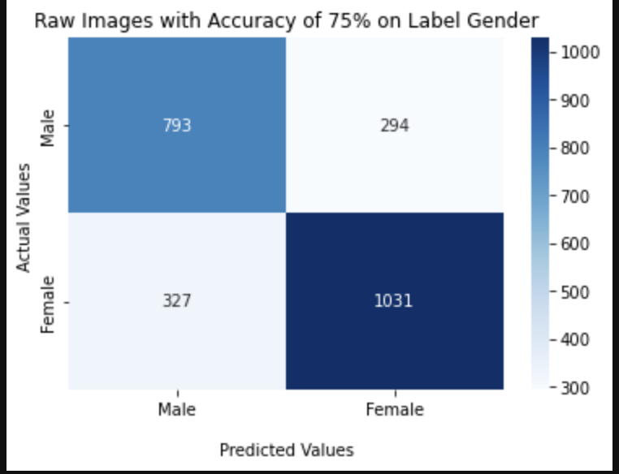
Random Forest + PCA, is it Faster?
Time: 2 min 35 s
Time: 1min 43 s
Time: 4 min 31 s
Time: 2 min
50 s
Notes:
The accuracy is the same but the PCA makes it fast

Slide 29
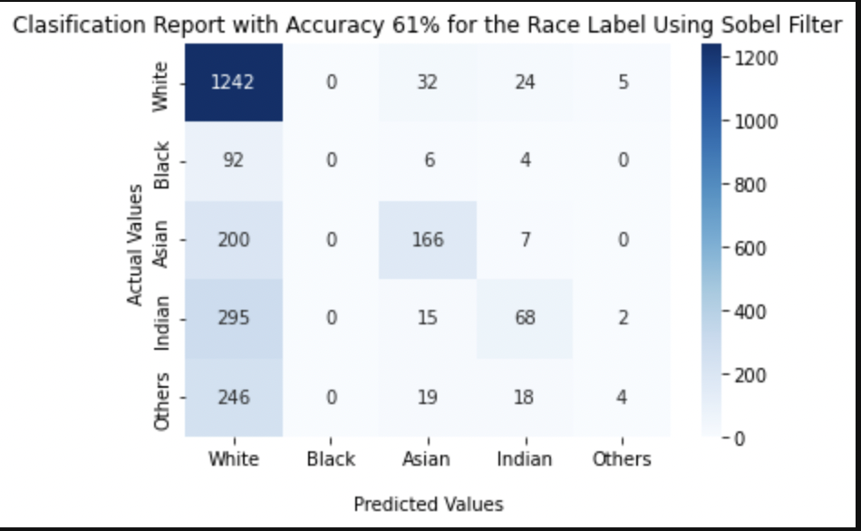
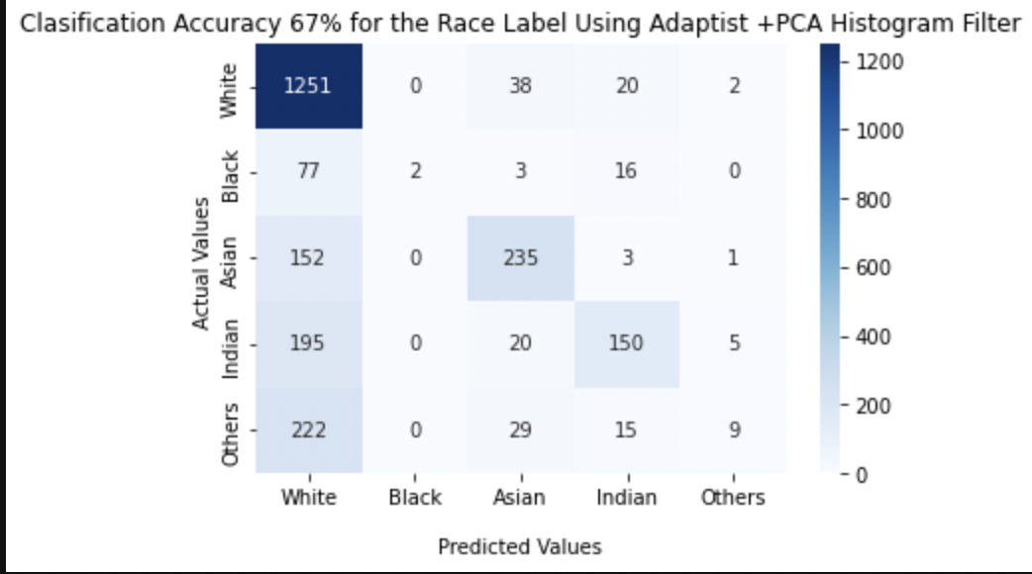
Classifier + PCA + Filters
Doing worse than raw images
Notes:
The accuracy here is low but the speed for the model is good

Slide 30
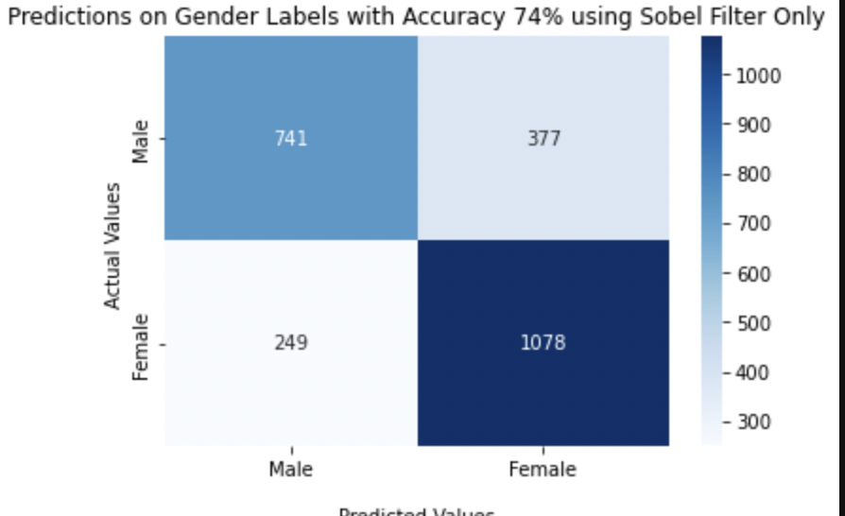
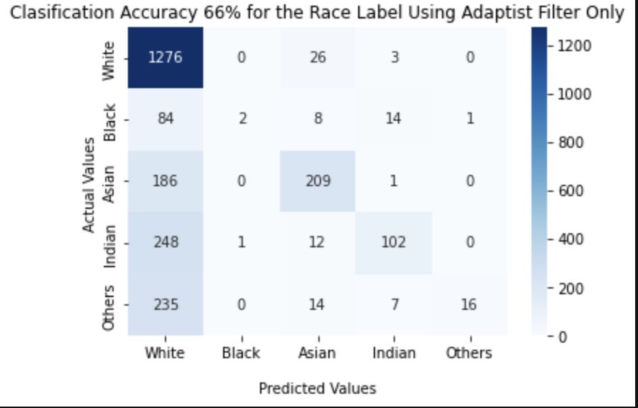
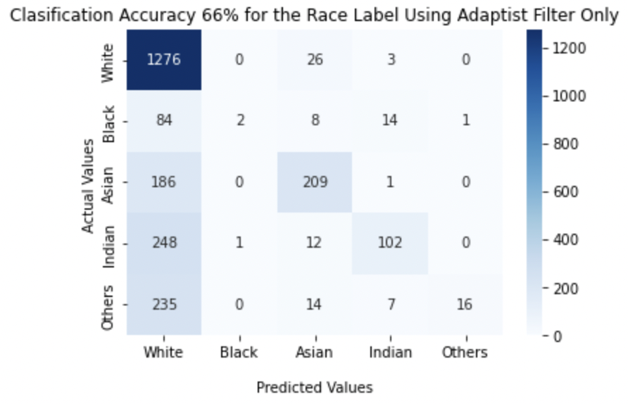
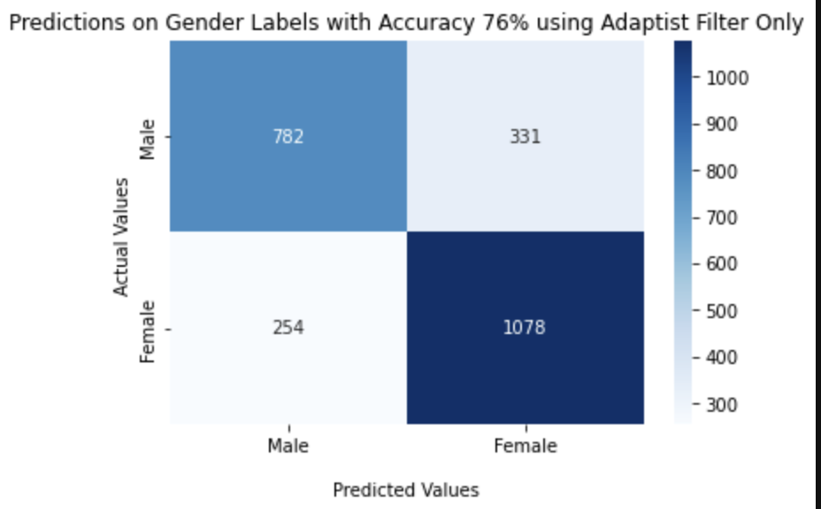
Again With Filters No PCA
Notes:
The speed is the same as the raw images but the accuracy decreased! The exception is the gender for the botton rigth on adaptist filter which is slightly better with 76%

Slide 31
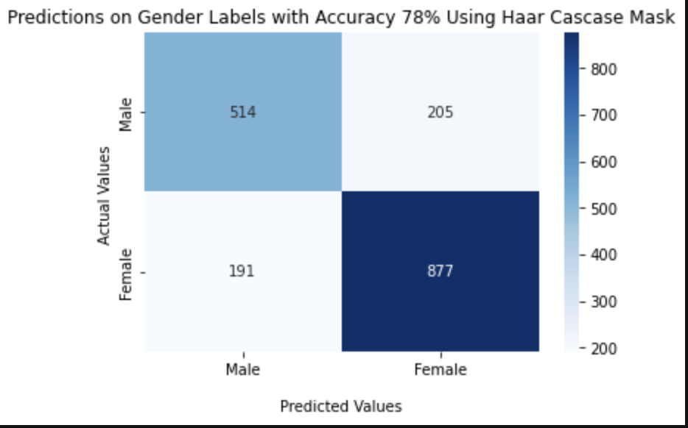
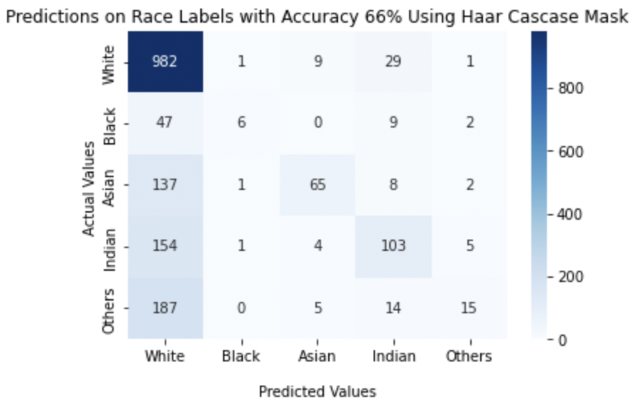
Haar Cascade Mask
Notes:
The Masked used with the help of Haar Cascade reduce the number of inputs but prove to be more accurate on the gender label overall

Slide 32
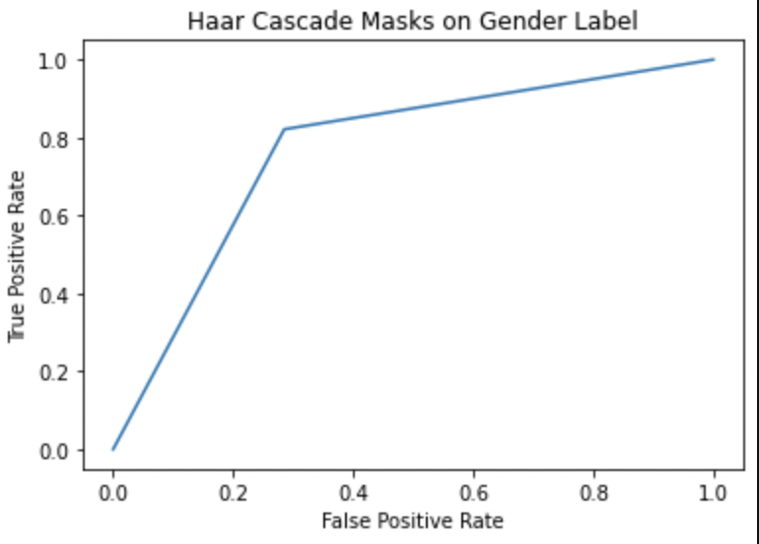
How Good is it? Sensitivity and Specificity (ROC) RF
78% accuracy
Notes:
Taking the best performing model with HAAR cascade this verifies that is indeed a good model as is on the top left corner

Slide 33
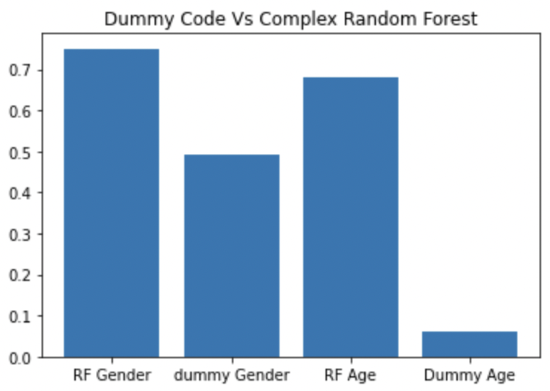
Sanity Check Comparison
Notes:
The model seems to be doing well but this shows that is indeed better than randoms guessing. Scores: [0.75, 0.49120654396728014, 0.68, 0.06134969325153374]
(just in case)

Slide 34
SVM on Age+Sift+Masks
 | SVM | SVM-Sift | Roberts Mask | Sobel Mask
Train acc.score | 0.99 | 0.33 | 0.99 | 0.97
Test acc.score | 0.43 | 0.26 | 0.41 | 0.19
Sift is best feature extraction for the SVM model

Slide 35
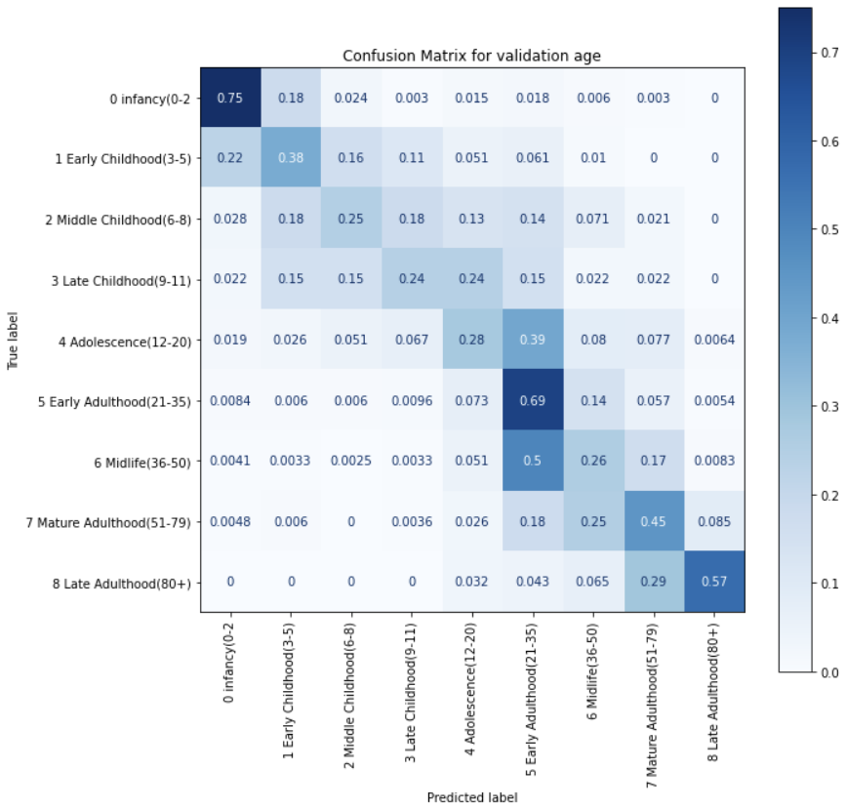
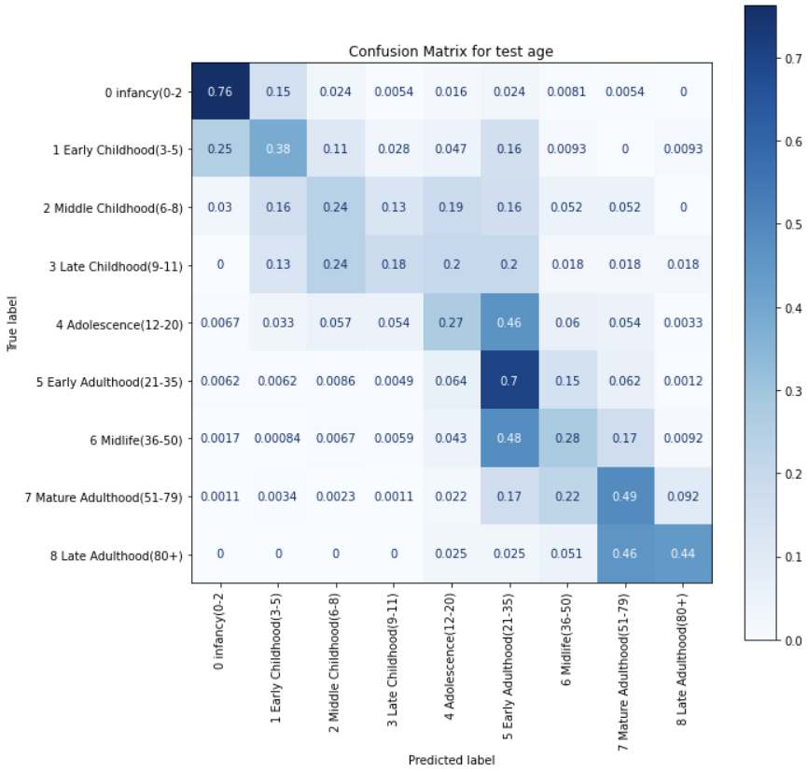
Neural Network Training on 5000 samples
Validation Accuracy: 0.49 Testing Accuracy: 0.50

Slide 36
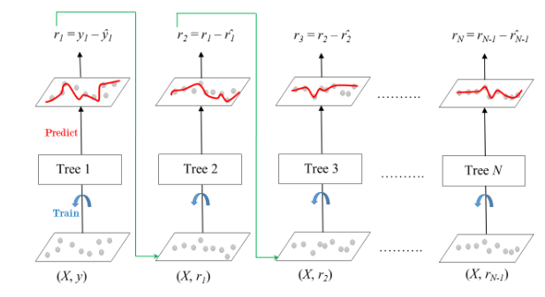
Gradient Boosting Classifier
Boosting is an ensemble method to aggregate all the weak models to make them better and the strong model
Gradient boosting is a successive model learns from the mistakes from the ones before it.

Slide 37
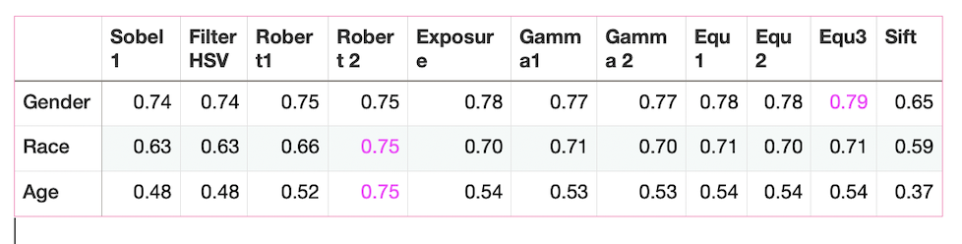
Gradient Boosting + 10 Masks + Sift - - test Accuracy
After balanced labels and sample 5000 images for age prediction. The accuracy is turn to 0.45

Slide 38
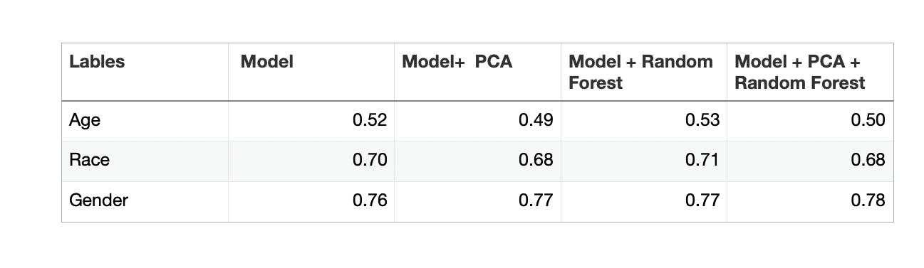
Gradient Boosting test accuracy with PCA and RFS

Slide 39
The Models which we have built and explored
The base model we have explored
Random Forest Classifier
SVM
Gradient Boosting Classifier
CNN
Simple models
KNN
Logistic Regression
Dummy Model

Slide 40
Sanity Check, is the Model Better than Dummy Models & Simple Models?
Simple Model Accuracy: KNN (Age = 0.27), Log Reg (Age = 0.46)
Dummy Model: Gender = 0.50, Race = 0.08, Age = 0.06
In general, accuracies for each model and label are higher than respective labels in the Simple and Dummy models

Slide 41
Model Choice
The two final models were chosen based off their validation accuracy on the age label
Gradient Boosting Classifier (A=0.52) and Convolutional Neural Network (A=0.50) were chosen

Slide 42
Hyperparameter Tuning

Slide 43
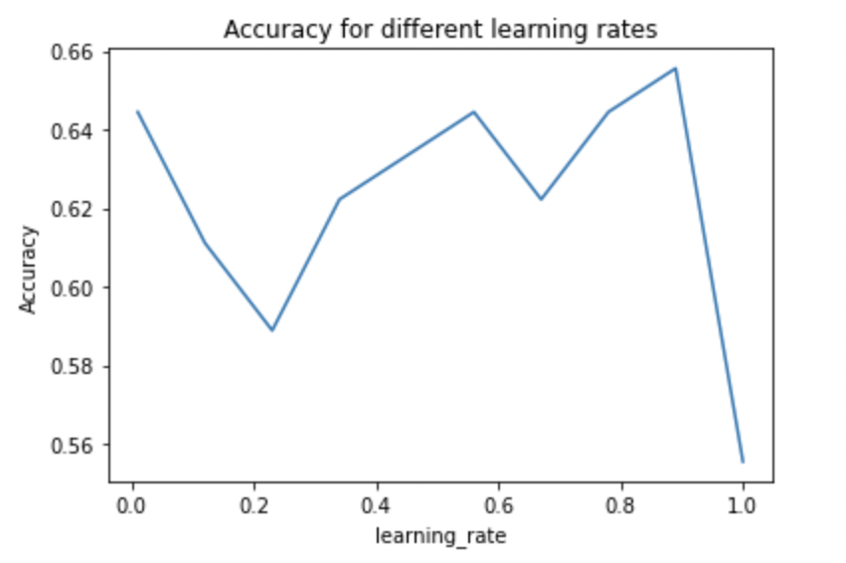
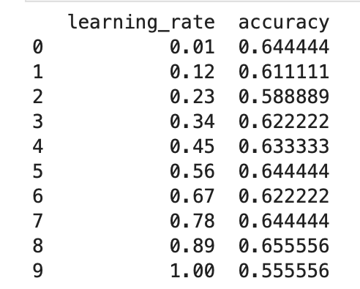
Gradient Boosting Classifier - learning rate Tuning
The best learning rate is 0.89

Slide 44
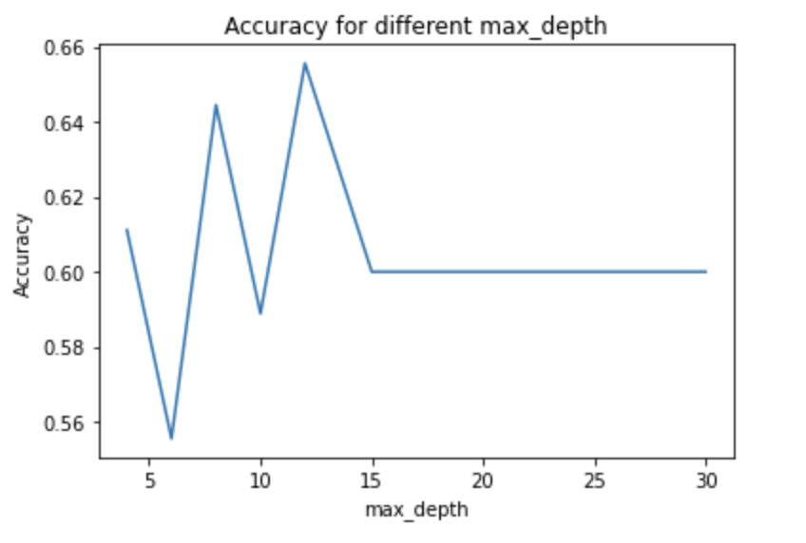
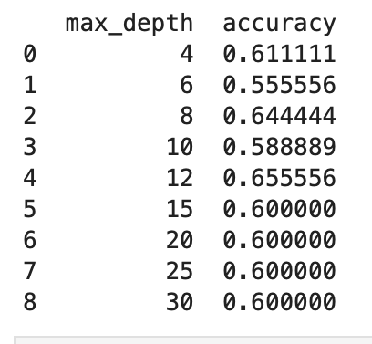
Gradient Boosting Classifier - max_depth Tuning
The best max_depth is 12

Slide 45
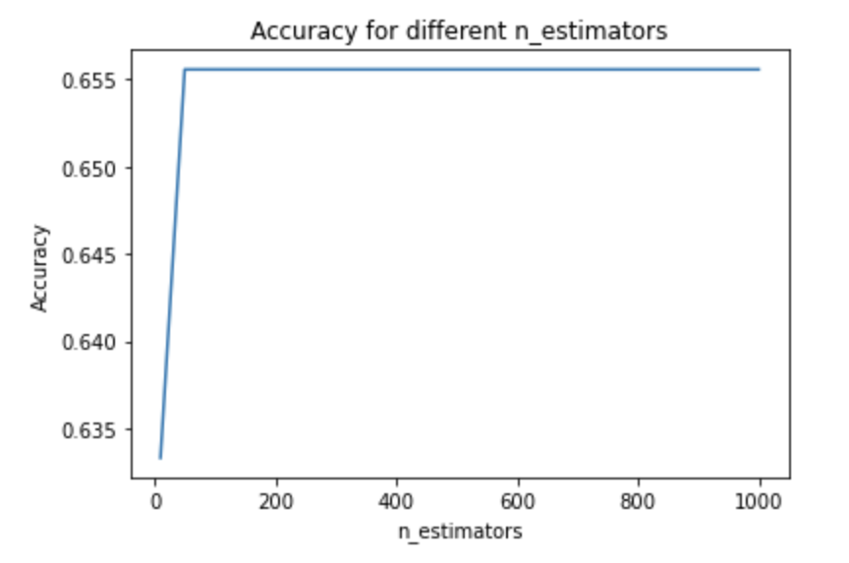
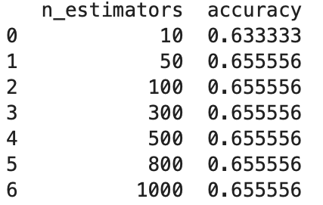
Gradient Boosting Classifier - n_estimators Tuning
The best n_estimators is 50

Slide 46
Convolutional Neural Network - Hyperparameter tuning
Best Results:
Filter: Sobel
l1regularization - 0.0
l2regularization - 0.0
Dropout - 0.3
Structure:
Conv(32 Filters)
Dropout
MaxPool
Conv(32 Filters)
Dropout
MaxPool
Conv(32 Filters)
Dropout
Flatten
Dense(32 Layers)
Dense(Output = n classes)

Slide 47
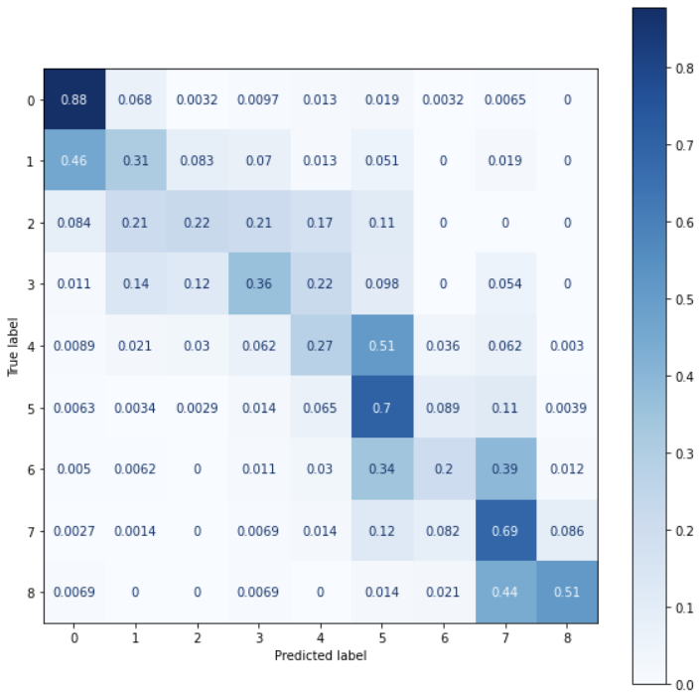
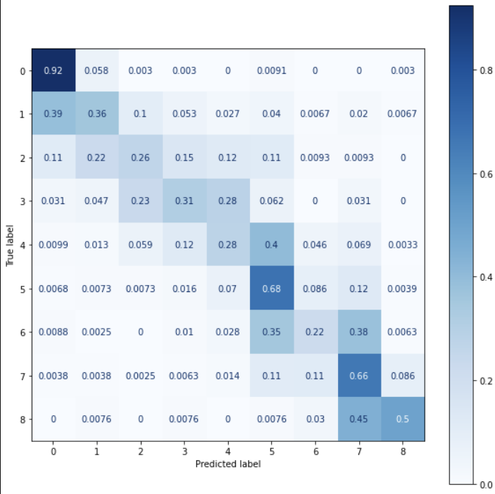
Convolutional Neural Network - Samples : 2000 - Results (Age)
Validation Accuracy: 0.56 Testing Accuracy: 0.56

Slide 48


Convolutional Neural Network - Samples : 2000 - Results (Race)
Validation Accuracy: 0.69 Testing Accuracy: 0.68

Slide 49


Convolutional Neural Network - Samples : 2000 - Results (Gender)
Validation Accuracy: 0.84 Testing Accuracy: 0.83

Slide 50
Conclusion: The best Model Machine Learning Pipeline
Preprocessing:
Balancing Labels tends to improve accuracy
Use SIFT with or without PCA/RFS for faster training at the cost of accuracy
Use Masks to modify images and test for greater accuracy
Model Design:
Hyperparameter tuning can add accuracy, but will take additional time
If working with a deep model, slowly increase accuracy to avoid overfitting

Slide 51
What comes next?
Feature extraction from both CNN and GBC
Organize and modify the code base
Final report

